Slide 1
The first wireless remote controlled boat was built by Nikola Tesla influencing military signalling devices by incorporating radio waves
-> boosted the development of robotic machines
Unimate, the first arm robot was introduced for performing repetitive or dangerous tasks on a General Motors assembly line
Turing test was published by Alan Turing to test whether a machine has the intelligence to think for itself
Aristotle expressed a brilliant idea of having a few robots around
322 B.C.
1898
1950
1962
1495
1940
1956
A robotic knight was designed by Leonardo da Vinci making the knight move like a person
“Three Laws of Robotics” was created by Isaac Asimov
“artificial intelligence” was coined as a result of the conference at The Dartmouth Summer Research Project on Artificial Intelligence in the Dartmouth College

Slide 2
Shakey, the first mobile robot was developed by the Stanford Research Institute for reacting to its own actions with sensing devices equipped
ASIMO, a humanoid robot was presented with the ability to walk 1mph, climb stairs, recognise faces, gestures and objects’ movements and to react to voice commands
Wabot-2, a musician humanoid robot was created to communicate with a person and play a keyboard instrument
Persia, the first humanoid robot in Iran
1966
1984
2000
2004
1977
1999
2002
2014
Star Wars was announced with R2-D2 and C-3PO robots which had inspired further researches on humanoid robots
AIBO, a robotic pet was introduced by Sony to learn by interacting with the environment and respond to more than 100 voice commands
DARPA’s Centibots Project: proved that a large number of robots (100 robots) can be coordinated to achieve a single goal
Pepper, a humanoid robot was introduced to read emotions

Slide 3
Industry Applications:
1. Healthcare industry + examples
2. Childcare industry + examples
3. Customer service industry + examples
Number of IP or patents
Google trend
Number of companies working on humanoid robots
Key Technologies:
Cloud computing
Big data analytics
Machine learning
Sensors
Natural language processing
Data security
Battery
Current Situation:
Market overview
Technological architecture
Law and regulations
Social problems (social norm)
Robotic Development History
Physical Evidence - all participating countries involved in humanoid robots’ R&D
Conceptual Evidence - legal structure & social norm
Predictions: 1. Population of humanoid robot (growth rate)
2. Performance of humanoid robot
3. Market value
4. Price
Spatial Evolution

Slide 5
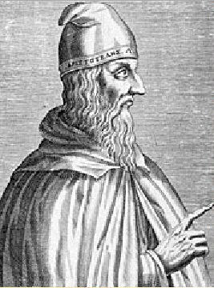
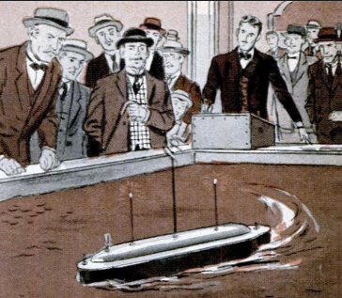
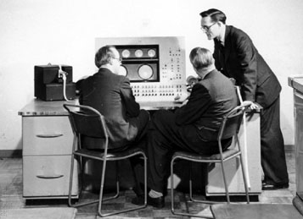
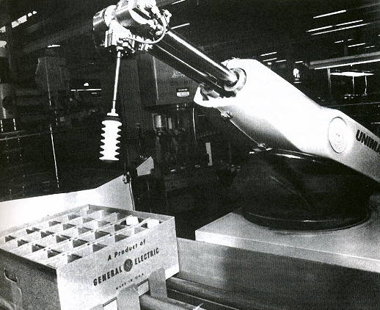
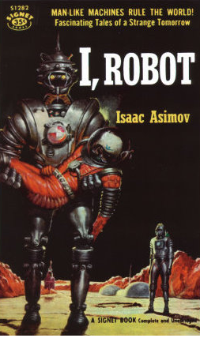
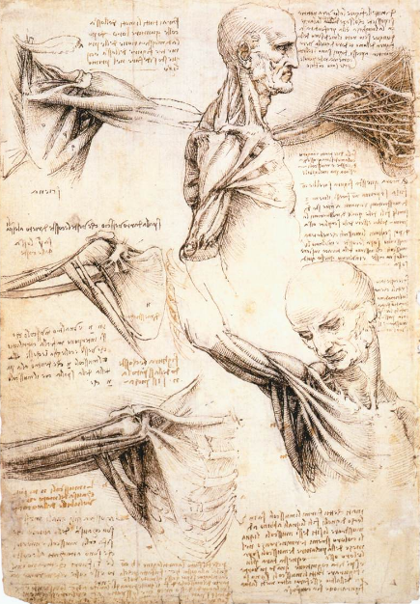
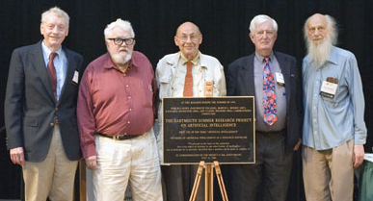
322 B.C.
1898
1950
1962
1495
1940
1956

Slide 6
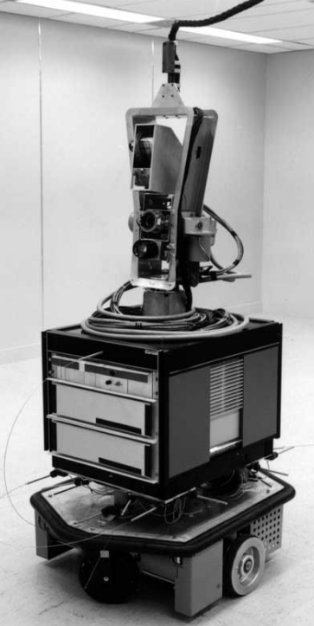
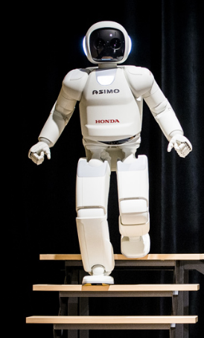
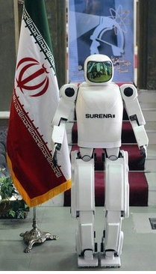
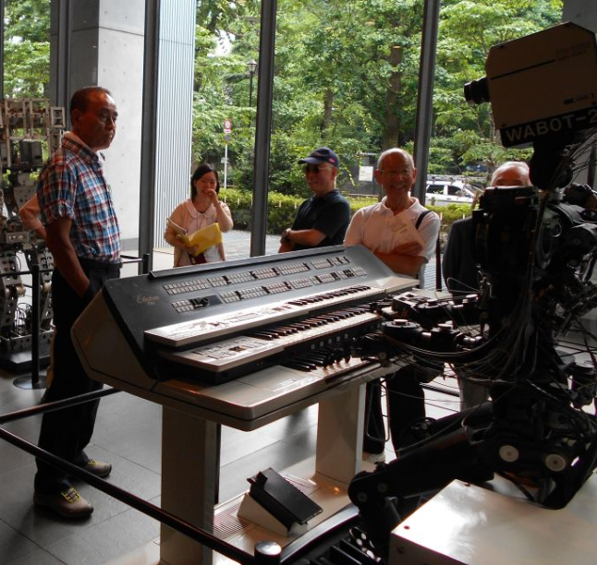
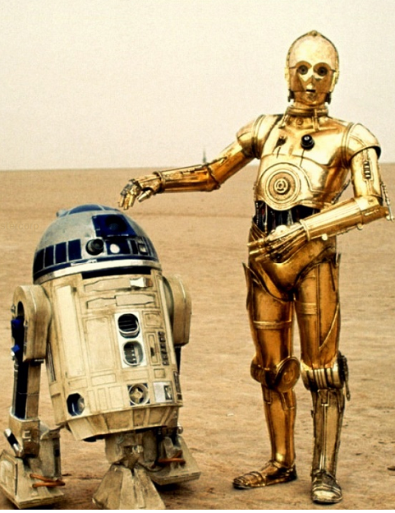
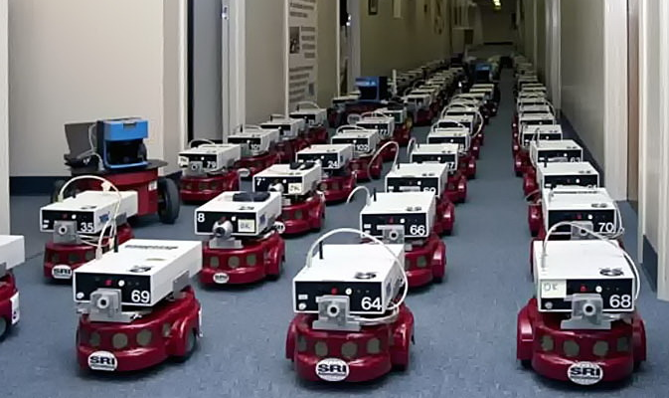
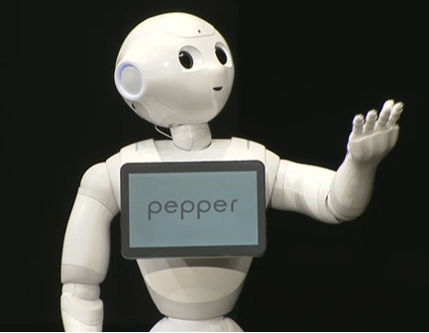
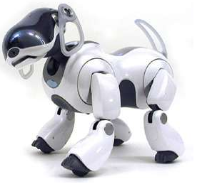
1966
1984
2000
2004
1977
1999
2002
2014

Slide 7
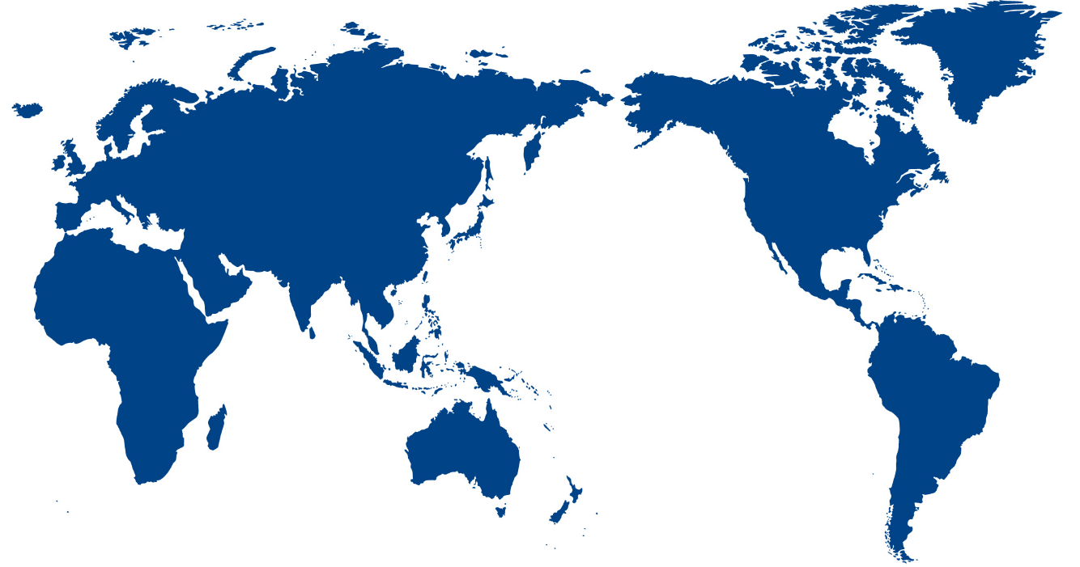
Global Location of Humanoid Robots Application
Russia
UK
Italy
US
Greece
Japan
Iran
322 B.C.
1495
1898
1940
1950
1956
1962
1966
1977
1984
1999
2000
2002
2004
2014
Timeline

